Slide 1
Flow Approval Processes
Tom Rook

Slide 2
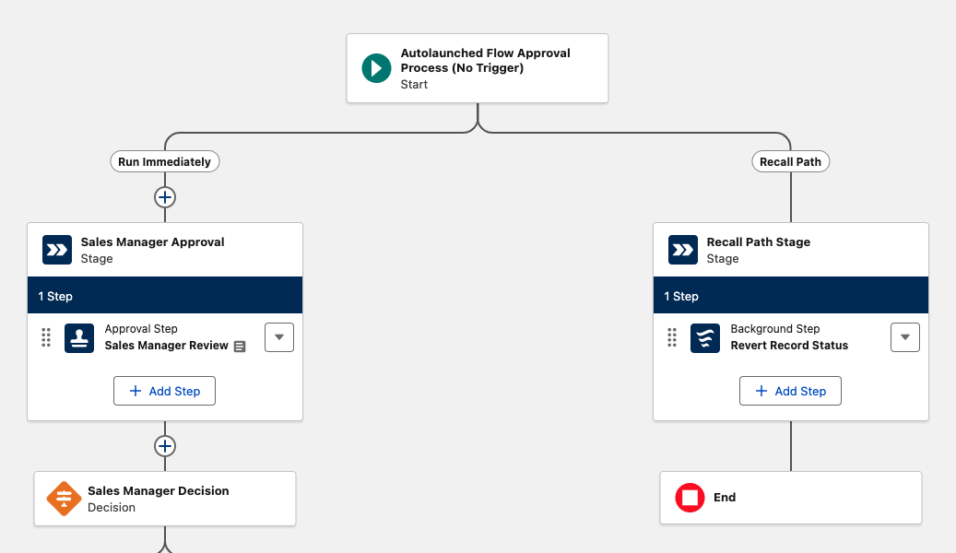
What Exactly are we talking about?
Spring ‘25
What was a paid product became Free!
Is this goodbye?
Two releases of enhancements, is Classic Approvals going the way of Process Builder?
Pretty Cool!
But you must be up on your flow knowledge, this uses sub flows for everything!
So what is this release about?
Feature parity!

Slide 3
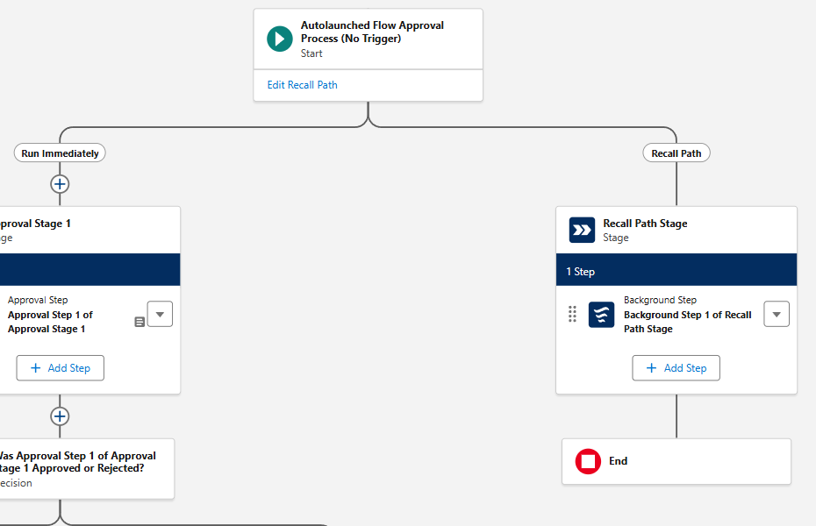
Recall Path for Approvals
What Even is a Recall?
When the submitting user pulls back an approval
What can I do?
Configure the recall
You can add ONE Stage
And that Stage can have “Background Steps”
Why?
Data Clean Up - Change fields, roll back a stage etc.

Slide 4
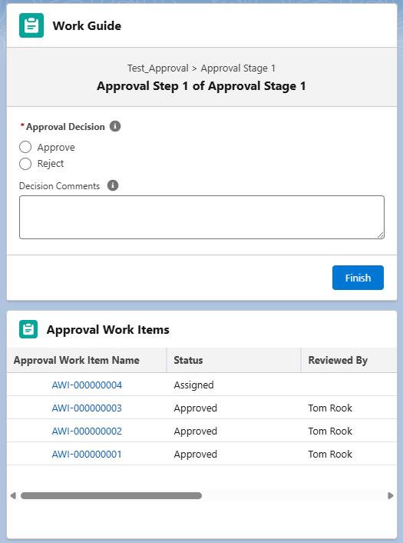
Flow Approval Process Delegation
Feature Parity!
Uses the existing “Delegated Approver” Field on a user Record.
Where does this information appear?
In their Approvals App
In the Work Guide or Approval Work Items components on the record page
When does a delegate see this?
Always!
Impact
Eliminates approval bottlenecks during approver absences

Slide 5
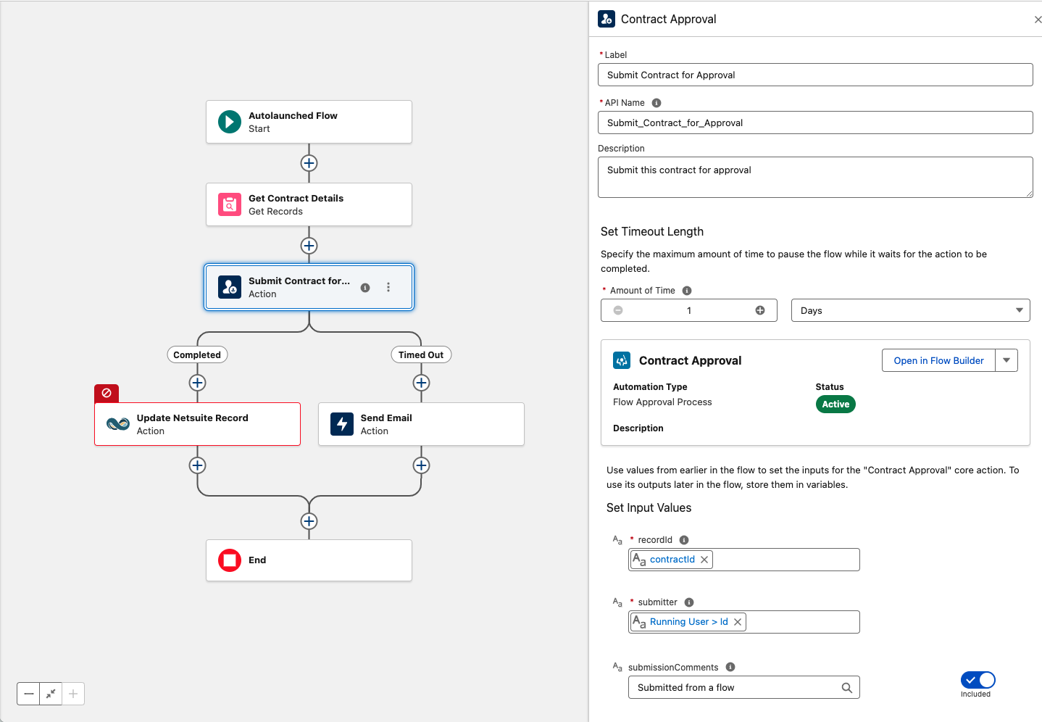
Submit a Flow Approval from a Flow
Action
Select any flow approval from inside of an Action Component.
Configure
Time out length, in Minutes, Days, Hours or Months
Input Values
Output Values
Completed or Timed Out behaviors

Slide 6
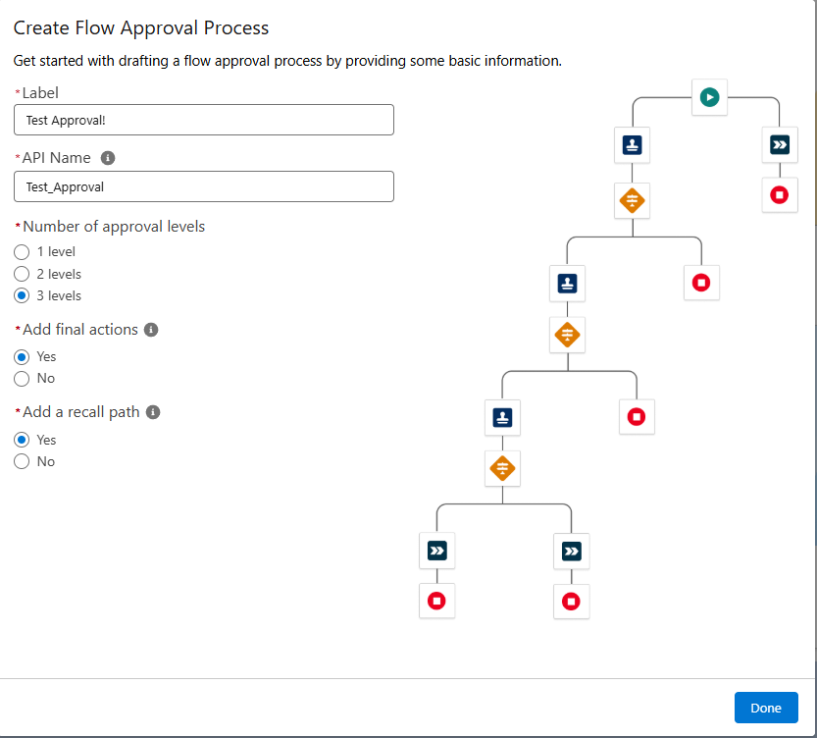
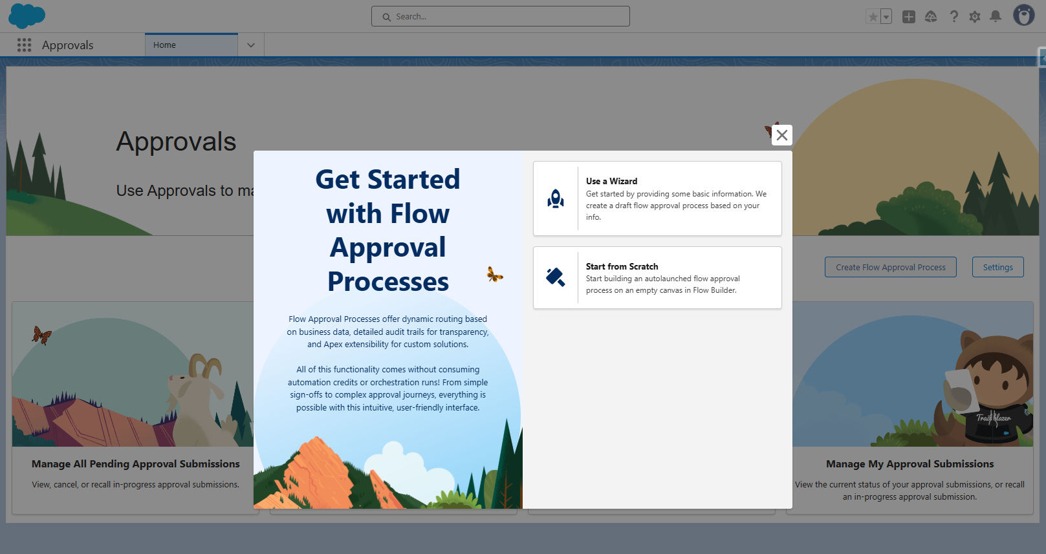
Flow Approval Wizard
Approvals App?
App Launcher > Approvals
Can manage approvals but also create Approval Processes.
Reverse Engineer
If you are new to flow approval use this wizard!
Levels
Upto 3 levels
Final Actions
Recall Path
Auto Launched Only
Record triggered can be created directly from flow
Notes:
Feature parity!

Slide 7
Q&A

Slide 8
Thank You!
tomrook.co.uk

